Slide 2
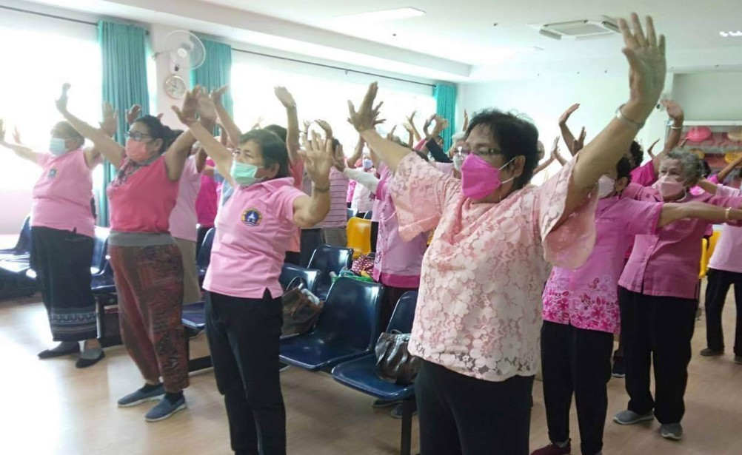





SE2024050
Health Promotion Project for the Elderly in Bo Sap Community, Nakhon Si Thammarat Province.
Assistant Professor Kamlai Somrak
Lecturer Saowanee Chaiyawan
Assistant Professor Namfon Ritthipakdee

